Slide 1
Project Team Kick-Off
[Project Name]
Speaker Name
Ref: 0001463
June 2022

Slide 2
User instructions
PLEASE REMOVE THIS SLIDE BEFORE PRESENTING
Who: This deck is built for delivery of a ServiceNow product/capability. The delivery of this deck may be undertaken by Customers, ServiceNow Partners and ServiceNow Expert Services. Business Process Consultants/Business Process Analysts will normally be responsible for its delivery.
Why: We want to make it easier for you by spending more time on the implementation and build, not creating workshop materials. The purpose of this presentation is to add content to the Project Team Kick-Off Presentation (available in Now Create), that formally starts the implementation.

Slide 3
User instructions
PLEASE REMOVE THIS SLIDE BEFORE PRESENTING
How:
Customers (self–implementation) – use the deck as it is or add to your corporate template. Alternatively, utilize individual slides to enhance your internal communications
Partner or Co-Delivery implementations - use the deck and add your logo, following the instructions on a following slide.
ServiceNow Expert Services
remove the PartnerLogo using the Slide Master (View > Slide Master > select the vertical line and the PartnerLogo at the bottom of the Master Slide and delete. If you see any other instances of PartnerLogo just follow the same process from that slide). If you have any issues, please contact the Now Create Team via the Teams channel
Tailor the presentation for the needs of your specific implementation

Slide 4
FAQs
PLEASE REMOVE THIS SLIDE BEFORE PRESENTING
How can I provide feed on this asset or other parts of Now Create? The Now Create has a number of feedback buttons throughout the portal. When opening an asset, before you download it, there is a feedback button in the bottom right of the screen. Click on it and a small form will appear for you to leave specific feedback regarding the asset you are accessing.
If we use this deck, or slides from this deck, are we breaking any copyright? No. We designed this deck to be used by our whole ecosystem.
What should I do if I don’t need all of the content contained within this, or other assets? You can either hide or delete the slide(s). You may also want to move the slide(s) to the end of the presentation, review it when you have finished updating the asset for your own use, and then deleting any content you don’t need. Remember to regularly check Now Create to make sure you have the most up-to-date asset.

Slide 5

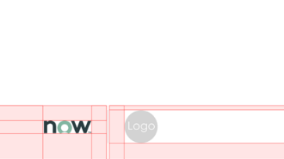


Adding your Logo
PLEASE REMOVE THIS SLIDE BEFORE PRESENTING
To provide credibility to ServiceNow documents, the ServiceNow and your logo should be visible, but not domineering.
Click View > Slide Master > Slide > Select Page 1
What to do:
Download logos from the Brand Center site.
Scale logos to an exact height of 0.45cm.
Place your logos after the ServiceNow logo, divided by a grey bar.
The same rule should be applied when more than one partner logo is required.
What not to do:
Do not scale logos beyond 0.45cm height
Do not stack ServiceNow and Partner logos

Slide 6
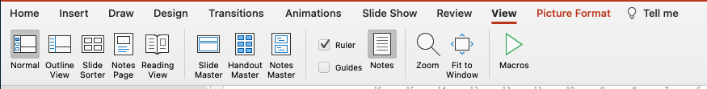
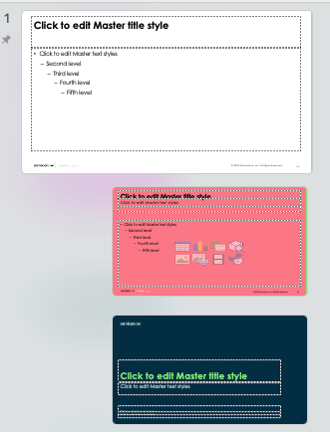

Deleting the PartnerLogo
1.
PLEASE REMOVE THIS SLIDE BEFORE PRESENTING
2.
What to do:
Click ‘View’ at the top of the screen
Click on ‘Slide Master’ - this takes you to the slide master for the slide you are looking at
Scroll up to Slide 1 in the master view. You may have to pull out the view on the left slide, so you can see all of the slides. Slide 1 will be the slide that looks larger than all the rest. It’s kind of the master of that group of slides.
At the bottom of the slide there are 2 shapes that you can highlight. A small vertical grey line and the PartnerLogo text.
Once highlighted, simply press delete. That should remove the PartnerLogo from the slides.
3.
4.
5.

Slide 7
Welcome & introduction
Welcome
Meeting objectives
Agenda
Housekeeping
Introductions

Slide 8
Objectives

Slide 9
Meeting objectives
Introduce the teams
Project Team
[Business] Team
Confirm the common vision of outcomes
[Business] vision
Review the Project scope
Scope
Assumptions
Timeline
Project governance overview
Ingredients for success
Out-of-the-box
Escalation paths
Communications plan
Organization
Roles & Responsibilities
Implementation Methodology
Now Create
Next steps
Workshops
Notes:
Best Practices Tip: Reinforce the objectives of the Kickoff meeting.
The Team is here to:
Introduce the Teams
Communicate the common vision for the project outcomes
Confirm the scope – what was agreed in the Business Case/Project Charter and what will be implemented
Key Assumptions – general & project
Timeline – projected resource utilization, phase durations and estimated completion date
Governance – suggestions for a successful project, based on previous experience
Delivery method – a high-level review of Now Create and how Scum/Agile is applied within the project lifecycle
Try not to discuss the details of scope, timeline and method of delivery at this point. Each topic is in a separate section in this deck.
The Team Kickoff Meeting concludes with a review, open discussion and summary of next steps, including workshops and what is needed from all concerned. Ensure the Business Execs and stakeholders are present for this closing session.

Slide 10
Agenda

Slide 11
Agenda
Update this slide based on your workshop content
Welcome & Introduction
Business Value & Objectives
Project Scope Overview
Project Governance
Implementation Methodology
Sources of Additional Information
Next Steps
Closing

Slide 12
Housekeeping
Notes:
Best Practices Tip: Take a few moments to talk about general housekeeping items. Set proper expectation around business continuity. However, if at all possible have focus on the meeting and not on cell phones and email.

Slide 13
Housekeeping
For virtual/hybrid workshops. Update depending on which application you are using to run your workshop
Time
Presence
Collaboration
We’ll aim to start and finish on time
Breaks will be taken as needed; approximately every 1-2 hours
Please return from breaks and lunch promptly; if late, please catch-up during breaks or after the workshop
If you are comfortable, please keep your Webcam on
Please let the host know if you need to leave the workshop, via the chat
Avoid temptation to multitask while in the workshop
More than 3 second’s silence = concurrence with the point made
All phones on vibrate and make sure you mute your microphone when not contributing to the discussion
Maintain a positive atmosphere – everyone’s ideas are valued
Please wait for one speaker to finish. Feel free to raise your (virtual) hand if you would like to make a point
Discussion topics needing greater detail will be recorded in a “Parking Lot” for later resolution
Everyone’s ideas are valued
Have fun! ☺
Notes:
** USE THIS SLIDE IF DELIVERING THE WORKSHOP IN A VIRTUAL OR HYBRID FORMAT **
Explain and discuss
Review the housekeeping with workshop participants.
Key points to highlight:
If participants come back late from a break or lunch, you will not be able to repeat what they missed during the session. They need to catch up on another break or after workshop.
Silence phones and step away if you need to use the phone.
Try to stay focused. Emails, phone calls, texting, working on other things, etc. can cause missed, unclear, or un-agreed requirements which leads to additional time to deploy.
There are no titles in the room. Everyone’s opinions, challenges, and ideas should be shared if it could be a input to a requirement.

Slide 14
Housekeeping
For in-person workshops. Update depending on your location, e.g. you may have to add fire exit information
Time
Presence
Collaboration
We’ll aim to start and finish on time
Breaks will be taken as needed; approximately every 1-2 hours
Please return from breaks and lunch promptly; if late, please catch-up during breaks or after the workshop
In the case of an emergency…..
All phones on vibrate. Please leave the room if you must take a call
Avoid temptation to check email. Please keep laptops closed unless taking notes or working on something for the Workshop
More than 3 second’s silence = concurrence with the point made
Maintain a positive atmosphere – everyone’s ideas are valued
Active participation and listening
Discussion topics needing greater detail will be recorded in a “Parking Lot” for later resolution
Everyone’s ideas are valued
Have fun! ☺
Notes:
** USE THIS SLIDE IF DELIVERING THE WORKSHOP IN A MORE TRADITIONAL MEETING ROOM ENVIRONMENT **
Explain and discuss
Review the housekeeping with workshop participants.
Key points to highlight:
If participants come back late from a break or lunch, you will not be able to repeat what they missed during the session. They need to catch up on another break or after workshop.
Silence phones and step away if you need to use the phone.
Try to stay focused. Emails, phone calls, texting, working on other things, etc. can cause missed, unclear, or un-agreed requirements which leads to additional time to deploy.
There are no titles in the room. Everyone’s opinions, challenges, and ideas should be shared if it could be a input to a requirement.

Slide 15
Introductions
Notes:
Best Practices Tips: Keep your personal introductions short and to the point. You should provide;
Name
Title
Time with Company/Business
Applicable experience

Slide 16

Introductions
Name
Title
Role on this Project
Notes:
Best Practices Tips: Keep your personal introductions short and to the point. You should provide;
Name
Title
Time with Company/Business
Applicable experience

Slide 17
Roles & responsibilities

Slide 18
Roles & responsibilities
Example - update with specific roles needed to successfully complete the workshop
Customer Role | Name | Key Responsibilities
Business Sponsor | [Name] | Provides business context and guidance to the project manager and team Champions the project, including advocating and securing support from cross-functional departments
Business Process Lead | [Name] | Oversees and consolidates the KPIs for processes​ Oversees and approves the variations of global processes based on regional requirements​
Process Owner | [Name] | A subject matter expert of the process Defines the process mission, vision, tactics, goals, objectives, KPIs and monitors the KPIs​ Is accountable for the process​
Program Manager | [Name] | Coordinates multiple projects to ensure they benefit each other and align with overall business goals​ Provides program leadership to execute the platform vision​
Project Manager | [Name] | Plans, manages and ensures the delivery of project releases​ Single point of contact for project status who tracks and communicates status while serving as escalation point​
Product Owner | [Name] | Maintaining the Product Backlog items, ensuring that the Product Backlog is visible, transparent, and clear to all, and shows what the Team will work on next Iteration planning and ordering the items in the Product Backlog to best achieve goals and missions
Notes:
Best Practices Tip: Use this slide to confirm who will participate and what role/responsibility they will have. You should also confirm the individual’s ability to make decisions.

Slide 19
Roles & responsibilities
Example - update with specific roles needed to successfully complete the workshop
Platform Roles | Name | Key Responsibilities
System Administrator (Sys Admin) | [Name] | Maintains stability and usability of the platform​, working with developers for the duration of the project Performs application maintenance to include performance monitoring error identification/remediation​, as well as instance security, user/group access, administration, access control lists, etc.
Platform Owner | [Name] | Leads team in alignment to business strategy, roadmap and platform governance​ Articulates vision and business value of building, supporting and developing the platform​ Overall ownership and oversight of ServiceNow instances​
Platform Architect | [Name] | Oversees, specializes and provides advice in one or more ITIL practices. (ITSM, ITOM, ITBM…)​ Designs and collaborates with Business Process Analysts and Developers in the creation of a High Level Solution Design Document Ensures technical governance and policies are being adhered to
Security Architect​ | [Name] | Reviews current system security measures and recommends and implements enhancements​ Conducts regular system tests and ensures continuous monitoring of network security​
Developer | [Name] | Designs, develops and configures ServiceNow applications and services​ Delivers new functionality across applications
Notes:
Best Practices Tip: Use this slide to confirm who will participate and what role/responsibility they will have. You should also confirm the individual’s ability to make decisions.

Slide 20
Roles & responsibilities
Example - update with specific roles needed to successfully complete the workshop
Platform Roles | Name | Key Responsibilities
Business Process Analyst | [Name] | Leads business process definition, re-engineering, improvement and gap analysis of current and to-be processes during workshops with key sponsors and stakeholders Identifies areas of process improvement (efficiency and effectiveness) and recommends solutions that detail pros, cons and risks
Test Manager | [Name] | Creates, maintains and improves comprehensive and well-structured test plans and suites Enables and coordinates Testers, instructs them on new or revised procedures and systems, provides oversight during the QA process and helps facilitate communication between testers and other team members​
Tester | [Name] | Reviews requirements and designs to create test cases Collaborates with Process Owners, Product Owners, Process Analysts and Technical Consultants to validate test cases as well as the test outcomes
Change Enablement Lead | [Name] | Designs and implements strategies to maximize the adoption of the ServiceNow platform across the organization Develop and lead a communication strategy and a plan for application rollout
Training Lead​ | [Name] | Responsible for the planning, development and execution of all aspects of User Training to support the organizational change and ServiceNow implementation
Communications Lead | [Name] | Develop a communications strategy to provide project information and status updates to project sponsors, the extended project team, directly and indirectly impacted stakeholders and the users
Notes:
Best Practices Tip: Use this slide to confirm who will participate and what role/responsibility they will have. You should also confirm the individual’s ability to make decisions.

Slide 21
Business value & objectives
Business value case
Objectives
Challenges & opportunities
Project critical success factors & KPI’s
Project approach

Slide 22
Project vision & outcomes
Update as needed
1
Text here
2
Text here
3
Text here
Notes:
Utilize slide(s) to present the vision and project outcomes communicated during the pre-planning meetings with the organization and Executive Kick-Off presentation.
If the business approves and it is available, use the business’s internal project marketing for the communication to the team to present a consistent message.
***Utilize the Appendix: Icon & Graphic library located in this deck to assist in conveying the project message
It is recommended that the Business Sponsor presents Project Vision and Outcomes

Slide 23




Objectives
Update as needed
Technical
Business
Product
Team
Additional content, if necessary
Additional content, if necessary
Additional content, if necessary
Additional content, if necessary
Notes:
Define what will be done in the project to achieve the Business Value Case, detailed in the previous slide.
Include the following Objectives, where necessary:
Technical
Business
Product
Team

Slide 24

Challenges & opportunities
Update as needed
Challenge…
Challenge…
Opportunities…
Notes:
Use this slide to outline the challenges that the business are currently facing and the opportunities for improvement.

Slide 25
Project critical success factors & KPI’s lists
Update as per Project Charter
Critical Success Factors
Key Performance Indicators (KPIs)
Critical Success Factors are determined by defining all activities necessary to deliver the value and objectives (defined on previous slides)
Determined by defining the performance metrics critical to meeting the Project Vision and Outcomes (defined on previous slides).
Key metrics can include Increased stakeholder value (user experience), ROI, defined improved business financial / performance measurement.

Slide 26
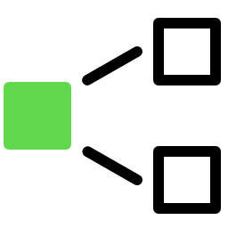


Project approach
Update as needed
Strategy
Methodology
Tools & Techniques
Keep to ‘Out-of-the-Box’ wherever possible
‘Now Create’ using Agile
ServiceNow Project & Portfolio Management, and Agile Development
Notes:
Update this slide to show the approaches that will be used for this project, taken from the Project Charter:
Strategies – what strategies will be targeted, e.g. keep to Out-of-the-Box. Details will be covered later in the slideshow.
Methodology – Waterfall/Agile; Now Create, etc. Details will be covered later in the slideshow.
Tools & Techniques – what tools will be used to manage the project, e.g. the ServiceNow Project & Portfolio Management, and Agile Development Applications

Slide 27
Project scope overview
Project Scope (applications & deliverables)
Assumptions (general and project)
Timeline
Things to note

Slide 28
Project scope
Replace/Update with project specific scope
Applications and deliverables
Applications | Platform Features | Integrations
Incident Management Change Management Problem Management | Knowledge Management Reporting Portal | SSO/SAML Lawson (Basic integration)
Notes:
Utilize this slide(s) to define Project Scope.
Project Scope must be specific and includes and include what will be delivered (applications / functionality)

Slide 29




General assumptions
Update as needed
Strong and engaged senior leadership
Process teams empowered to make decisions within a governance framework
Willingness and ability to change processes and behaviors first and software configuration last
Focus on an end-to-end process transformation instead of rebuilding legacy processes and constraints during the transition period

Slide 30






Project specific assumptions
Replace/Update with project specific assumptions
Define who is responsible for providing data; data modification; cleansing or alteration before, during and after importing data, as well as in what format data will be supplied
Define who is responsible for integration to and with other systems
Agree to use Out of the Box functionality and standard reporting. Deviation may have an impact on timelines, budget and on-going support
System Admin resources available to participate and configure the platform alongside the Technical Specialists/Developers, during the project
Define who is responsible for User Acceptance Testing
Agree if legacy system information and tickets will be migrated (not recommended).

Slide 31
Engagement timeline
Notes:
This is an example timeline only and should be used to demonstrate the order in which the phases run and approx. duration in relation to each other.

Slide 32
Timeline
Extend full color lines to indicate proposed Phase timings.
Phase |  | Sep-2020 | Oct-2020 | Nov-2020 | Dec-2020 | Jan-2020 | Feb-2020
INITIATE | Understand the customers business goals, begin the preparation work, staff the delivery team and formally kick off the engagement.
PLAN | Hold workshops to understand the customers’ process and platform needs. Finalize engagement timeline and refine configuration requirements.
EXECUTE | Run Agile Scrum cycles to realize business objectives and value through rapid configuration and transparent reporting
DELIVER | Support user acceptance testing; provide customer support readiness, go-live and post go-live support.
CLOSE | Formally close engagement, gather internal feedback and lessons learned, and assess success.
Notes:
This is an example timeline only and should be used to demonstrate the order in which the phases run and approx. duration in relation to each other.

Slide 33
Things to note
Update as needed
Joint responsibility: [Business] + Partner = Success
Project Charter is the official project agreement
Follow change control procedures to minimize scope creep
Out of scope ideas will be captured in the Product Backlog
Now Create is the implementation methodology
Quick team decision making (use Business Sponsor when needed)
Sys Admins are 100% committed & allocated
Collaborate freely with business, users and partners and raise issues immediately
Weekly Status Reports – full transparency

Slide 34
Project governance
Ingredients of success
Success is the outcome
Change management
Why Out-of-the-Box?
Decision making guidelines
Escalation process
Communication plan
Governance & Organization Chart

Slide 35
Eight ingredients of success
Projects are most successful when:
1
Business goals and measurements/KPIs are clearly defined upfront
2
Have executive sponsors who stay involved until the implementation is complete
3
Take a phased implementation approach to incrementally drive adoption
4
Put governance in place such as a RACI, for business and technical decisions
5
Commit to using out-of-the-box functionality
6
Engage experienced, certified and verified resources with deep domain expertise
7
Document training requirements and ensure budget to invest in training
8
Create change management plans and hold workshops for affected teams

Slide 36

Success is the outcome
Known strategy
Clear governance
Informed people
Optimized process
Maximized technology

Slide 37

Change management
All projects change
Let’s work together when it happens!
The Project Manager will co-ordinate this via the Change Request process
Process
Teams' drafts scope and requirements
Project Manager inputs into a Change Request
Change is evaluated and presented to Steering Committee, if necessary
It is important to note
Not all changes have a financial impact
Change orders are intended to help provide an audit trail of scope and activities
Notes:
Use this slide to provide a high level overview of the Project Change Control process using Change Requests

Slide 38



Why out-of-the-box?
Swift ROI
Ease of upgrade
Platform exploitation
Project delivered using Platform and Implementation best practice
Leaves a platform that is upgradeable, manageable, and supported
Provides the fastest and easiest path to implementing new functionality as it is released
Notes:
This slide should be used to underline the importance of an Out-of-the-Box implementation and what that means. If necessary, ask the Platform Owner or Platform Architect deliver this message.

Slide 39



Decision making guidelines
Edit as appropriate
Don’t lose sight
of the goal! Focus on capturing data that will increase platform capabilities and streamline processes
Closely examine
the additional benefits of capturing data compared to the additional costs incurred by maintaining it
Follow the 80/20 rule. What decisions will accommodate 80% of your situations. Do not let exceptions derail the entire process
Utilize rapid prototyping and iterative development to review and test the system to catch problems early on

Slide 40



Internal decision-making guidelines
Edit as appropriate
Information Security. Carefully consider who needs access to sensitive information.
Change management.
Don’t ignore or avoid difficult decisions. Escalate when needed.
Avoid the need for changes by avoiding introducing the non-essentials into the mix.
Strive for standardization. Exceptions should
be approved.

Slide 41
Escalation process
Update as needed
1st
2nd
3rd
4th
Project Manager
Escalation
Escalation
Escalation
Notes:
Agreed escalation process. If suppliers/partners are engaged, synchronize with their escalation process. May need parallel escalation paths.

Slide 42
Communication plan
Update as appropriate and agreed in Project Charter
Communication | Timing | Purpose | Audience
Executive Status Meeting/Report | Bi-Weekly | Formal communication for distribution and review of milestone timeline and project health to Project Steering Committee | Members of Steering Committee Program Manager and/or Project Manager
Project Status Meeting/Report | Weekly | Weekly status of planned vs. actual and project health. Review of business value case, milestones, scope, key risks and issues | Project Management Project Team Members
Sprint Standup | Daily | Collaboration within the Scrum Team ensuring visibility into what others are working on and challenges they face What will I do today? What did I accomplish yesterday? What obstacles are impeding my progress? | Scrum Teams
Notes:
Agreed communication plans as defined and documented in the Project Charter

Slide 43
Governance & organization chart
Update as needed
Bi-Weekly
Project Steering Committee | Name Here [Client] Role here Name Here [Client] Role here Name Here [Client] Role here
Weekly
Program Manager
Name
Daily
Project Manager
Name
Architecture & Technical Governance
Name
Business Value & Analytics
Name
Design, Build & Unit Test
Name
Organization Change Management
Name
Project & Program Management
Name
Support
Name
Testing
Name
Title
Name
Title
Name
Title
Name
Title
Name
Title
Name
Title
Name
Title
Name
Title
Name
Title
Name
Title
Name
Title
Name
Title
Name
Title
Name
Title
Name
Notes:
As agreed with the Steering Committee and documented in the Project Charter

Slide 44
Now Create overview
Now Create & demonstration

Slide 45
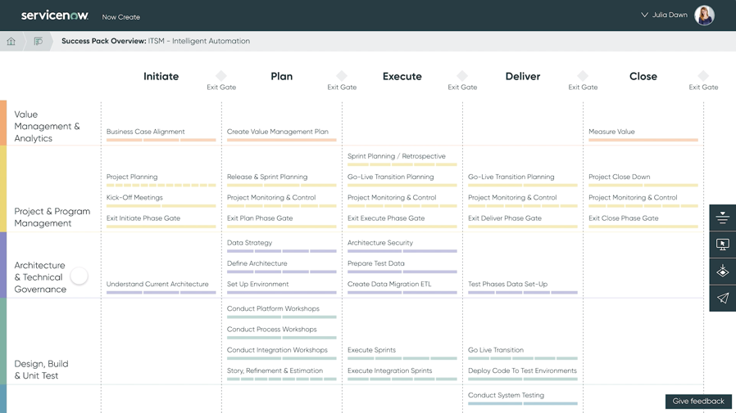
REMOVE this BOX Prior to Customer Engagement.
Whenever possible, the highly preferred way to explain the phases is by demonstrating the application live, with the talk track in the presenter notes.
Now Create
Centered on creating exceptional outcomes, Now Create offers a prescriptive methodology and over
900 leading practice assets
to guide your ServiceNow project
Notes:
<Select the appropriate Success Pack for your project and open the Success Pack overview screen>
Now Create follows hybrid waterfall methodology, with sequential project phases and exit gates, coupled with agile scrum development in the ‘Execute Phase’.
The 5 phases are:
Initiate – Understand the business objectives, Establish Project Governance, Establish the project team, Formally Kick-Off the project
Plan – Conduct Process, Platform & Integration workshops, Define and prioritize the product backlog, Release Planning, Finalize the project timeline, Document the Test Strategy, Setup the Environment
Execute – Run Agile Scrum cycles, Define support processes and Hypercare Approach, Execute Communications & Awareness Roadshows, Planning for System and UAT
Deliver – System Testing & User Acceptance Testing, Go-Live Planning, Operational Readiness, Training, Go-Live
Close – Operational Handover, Hypercare Support, Lessons learned, Measure value and champion success, Formally close the project
You will see that the methodology decomposes from the 5 phases into processes that are each named on the Success Pack overview screen. Each one of these processes decomposes further to tasks indicated by the dashed lines under the level 1 process title
Seven horizontal workstreams aggregate these process and tasks by logical groups of work centred around:
Driving the defined business outcomes for the project through the ‘Value Management’ and ‘Analytics’ and ‘Organisation Change Management’ workstreams.
Overall project governance and control through ‘Project and Program Management’.
Driving a high-quality solution through ‘Architectural & Technical Governance’, ‘Design, Build & Unit Test’ and ‘Testing’ workstreams.
Ensuring that the solution has on-going support and maintenance through the ‘Support’ workstream.
<Click into one of the task to show the detailed task screen and click through each tab>
To learn more about any of the tasks on the overview page simply click into it and you will be presented with the task level details, telling you:
Why this task is executed and the risk of not executing it. You can use this information to make risk based assessment on the need, or not, for a particular task for your project.
Who executes this task using common industry terms for the roles, against a Responsibility, Accountability, Consulted and Informed, RACI, matrix.
How the task is executed, guiding you on the execution of leading practices for the Success Pack to drive a high-quality result.
Inputs required for executing the task, of which you will find 3 types –
ServiceNow provided assets –in the form of leading practice detailed instructions related to the products within the Success Pack and other project templates and accelerators.
Project Created assets – these are simply outputs from earlier tasks within the methodology.
Organisation created assets – these are recommended inputs that will come from the implementing organisation, but outside of the project. An example might be the Project Business Case.
The Outputs tab shows us which outputs are created by this task, ready for consumption later in the project.

Slide 46
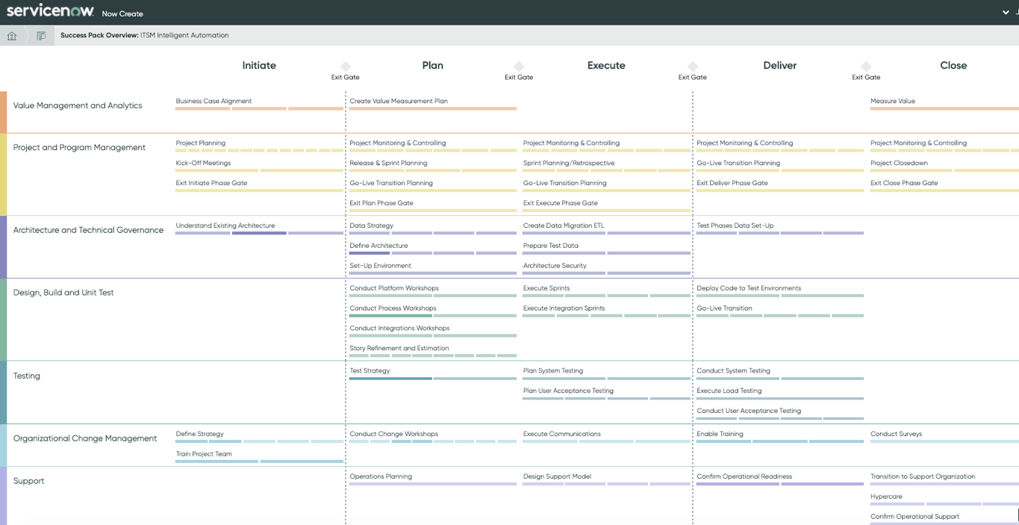
Now create is the keystone of implementation success
REMOVE this BOX Prior to Customer Engagement.
If unable to demo the application live, please use this slide to explain the benefits of Now Create.
Implementation methodology and library of leading practices
Step-by-step guidance arranged in a proven methodology for success
Now Create
Initiate
Exit Gate
Plan
Exit Gate
Execute
Exit Gate
Deliver
Exit Gate
Close
Exit Gate
Understand the business objectives
Establish Program Governance
Establish the project team
Formally Kick-Off the project
Conduct Process, Platform & Integration workshops
Define, review and prioritize the product backlog
Release Planning
Finalize the project timeline
Document test strategy
Setup environment
Run Agile Scrum cycles
Define support processes and Hypercare Approach
Execute comms & awareness roadshows
Planning for system and UAT
System testing & user acceptance testing
Go-live planning
Operational readiness
Training
Go-Live
Operational handover
Hypercare Support
Lessons learned
Measure value and champion success
Formally close the project
Practices, templates, and tools organized to achieve specific outcomes
Presented in an empowering user experience for any role
Designed to work well with other methodologies
www.servicenow.com/nowcreate

Slide 47


The heart of now create: Success packs
REMOVE this BOX Prior to Customer Engagement.
If unable to demo the application live, please use this slide to explain the benefits of Now Create.
Success Packs tailor ServiceNow’s core methodology for achieving specific outcomes with ServiceNow products. For example, creating a unified service center with HR Service Delivery
Success packs include all assets to guide an implementation including templates, leading practices, data packs, project accelerators and more

Slide 48
Step-by-step product-specific implementation guidance
REMOVE this BOX Prior to Customer Engagement.
If unable to demo the application live, please use this slide to explain the benefits of Now Create.
Curated from decades of implementation experience and product insight
Now create success packs – Implementation guidance by product and outcome
ITSM Success Packs
ITSM Intelligent Automation
Operate IT as a Service
ITSM Modernize IT Service Management
ITBM Success Packs
Foundational Application Portfolio Management
Foundational Project and Portfolio Management
Operate IT as a Service
HRSD Success Packs
Employee Lifecycle Journeys
Employee Service Delivery Foundation
Unified Service Center
Risk Success Packs
Business Continuity Management
Implementation
Governance, Risk, and Compliance Implementation
ITOM Success Packs
IT Operational Management Discovery, Service Mapping and Event Management
IT Operations Management Health
IT Operations Management Optimization
IT Operations Management Visibility - Discovery and Service Mapping
ITAM Success Packs
Hardware Asset Management Foundation
Software Asset Management Foundation
CSM Success Packs
Modernize Customer Service
Transform Self-Service Using ServiceNow Communities
Connected Operations – IoT Driven Field Services
Now Platform Success Packs
Create Your Own App
Establish the Platform Foundation and Security
Integration with External Solutions
Workplace Service Delivery Success Packs
Workplace Service Delivery Foundations
Field Service Management Success Packs
Field Service Management Digital Foundations
Security Operations Success Packs
Security Incident Response Accelerated
Security Operation Implementation Assessment
DevOps Success Packs
Foundational Enterprise DevOps
Safe Workplace Success Packs
My Safe Workplace
Now Intelligence
Predictive Intelligence Foundation
Performance Analytics Foundation
Virtual Agent Foundation

Slide 49
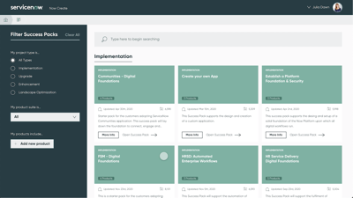
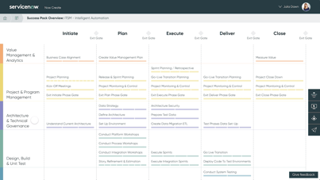
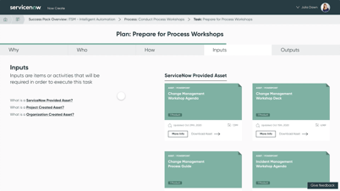
Now Create
REMOVE this BOX Prior to Customer Engagement.
If unable to demo the application live, please use this slide to explain the benefits of Now Create.
Key capabilities and design features
Tailored Success Packs for
all types of projects
Guidance tuned to each ServiceNow product and project type
Better implementations and upgrades
Outcome-driven approach
An elegant and intuitive
user experience
Repeatable methodology removing the anxiety of unknowns from projects
Leading practices and accelerators
Open to the ServiceNow community
Over 900 free-to-use assets to accelerate your success
Shorten your project activities duration
Make the right design decision
Don't re-invent the wheel

Slide 50
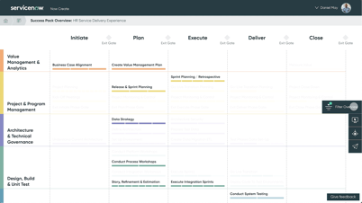
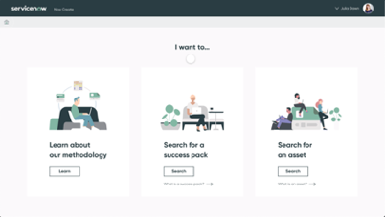
Now Create
REMOVE this BOX Prior to Customer Engagement.
If unable to demo the application live, please use this slide to explain the benefits of Now Create.
Benefits of using in a ServiceNow project
Bring perfect clarity to customer, partner and ServiceNow roles
Personalized experience to each delivery role
Roles and responsibilities orchestration
Fully exportable into ServiceNow PPM and other project execution tools
Execute your projects flawlessly and in perfect sync
Purpose driven decision making from real world experiences
Create new workflows fast, getting them right first time
Step by step guidance with enabling resources and accelerators
Grow yourself and your career with tiered development courses
Everyone should earn their Now Create Badge – in 20 minutes
Then ‘show off’ your expertise with the Now Create Micro-Cert

Slide 51
Sources of additional information

Slide 52








Empowering enterprise transformation
 | Webinars live |  | Webinars on demand |  | Training & certification
 | Knowledge base |  | Community |  | Develop program
 | Product documentation |  | Find a partner
Notes:
Empowering Enterprise Transformation
Becoming a ServiceNow customer means you gain access to a wealth of experience and knowledge offered by highly experienced ServiceNow Customer Outcomes and Customer Support teams, a global partner ecosystem, and a vibrant, fanatical community. These resources come together to create a support network that will be there every step of your transformation journey. This includes:
1 & 2. Webinars – both Live or On demand, these provide updates to spread the features and knowledge around latest ServiceNow Solutions.
3. Training and Certification - Best practice workshops, process and end user training, administrator and developer training, and an array of certification programs.
4. Knowledge - The largest gathering of service management professionals using cloud services to change the way people work.
5. Community - The ServiceNow Online Community brings together thousands of users, including customers, partners, and ServiceNow employees, to collaborate about a wide range of topics from how to's to sharing integrations and applications. The online community extends to many regionally-based face-to-face meetings in the form of ServiceNow User Groups (SNUGs) and Special Interest Groups (SIGs).
6. Developer program - The ServiceNow Developer program provides developers from any background with resources to learn, build and deploy applications on the Now Platform. It is the fastest, simplest way to kick start your future as a ServiceNow developer or up-level your existing skills.
7. Product documentation (Docs) – A centralized site where all the product documentation for the ServiceNow platform and ServiceNow applications for the enterprise is available.
8. Find a Partner: Global Partner Ecosystem - ServiceNow has attracted a who's who list of highly talented and proven system integrators, managed service providers, and solution providers to help you accelerate time-to-value

Slide 53
ServiceNow
Training and certification
https://www.servicenow.com/services/training-and-certification.html
On Demand Learning
Technical Training
Certifications
Custom Training
Change Enablement
Accelerators
Notes:
On Demand Learning
Hundreds of self-service, on-demand courses, organized by learning path and role
Technical Training
Skill up your technical and business team members to administer, implement, manage, and grow the platform
Certifications
Invest in your employees through industry-recognized certifications
Custom Training
Prepare your process and end users through hand-on, just-in-time training in your company’s ServiceNow instance
Change Enablement
Leverage our consulting experts to apply our proven change enablement methodology focused on user adoption that achieves your business outcomes
Accelerators
Accelerate user adoption with our guided workshops, tools, templates and out of the box training

Slide 54
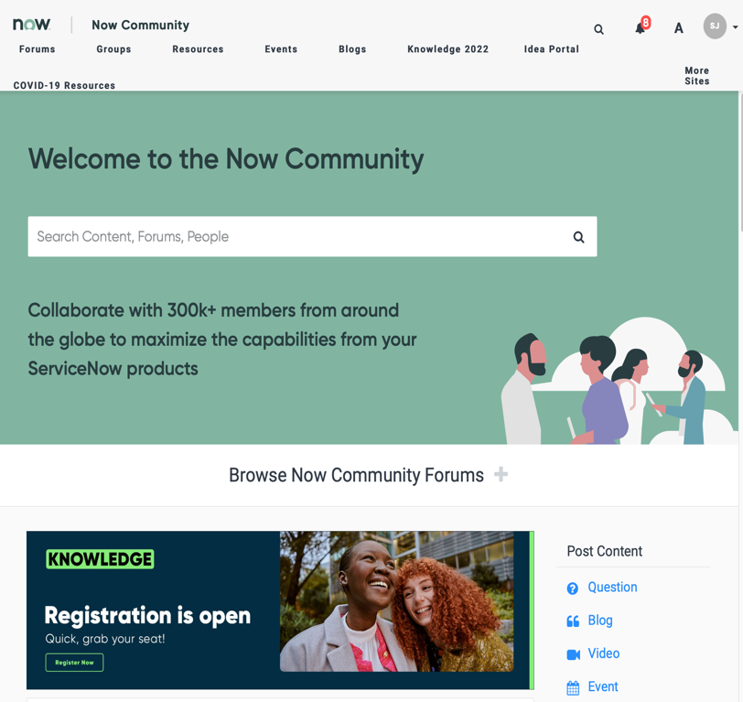
ServiceNow
Community
http://community.servicenow.com/
Forum
Questions & Answers
Learning Center
Training Videos, Training Books
Blogs
Variety of topics authored by Customers, Employees and Partners
Groups
Local User Groups and Special Interest Groups
Create an Account for additional access and join your SNUG (ServiceNow User Group)
Notes:
Review & Discuss:
Join the best thinkers for discussion, collaboration, and solutions on the ServiceNow online community and forums
Review the Community site
Discuss Local User Groups

Slide 55
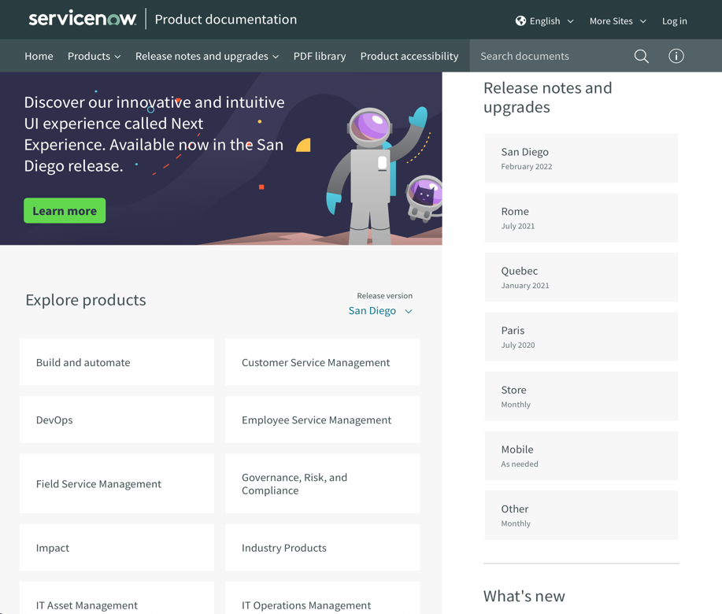
ServiceNow
Product documentation
http://docs.servicenow.com/
Product Overview
Detailed Product Documentation
Administration Guides
Release Notes
Notes:
Review & Discuss:
Join the best thinkers for discussion, collaboration, and solutions on the ServiceNow online community and forums
Review the Community site
Discuss Local User Groups

Slide 56
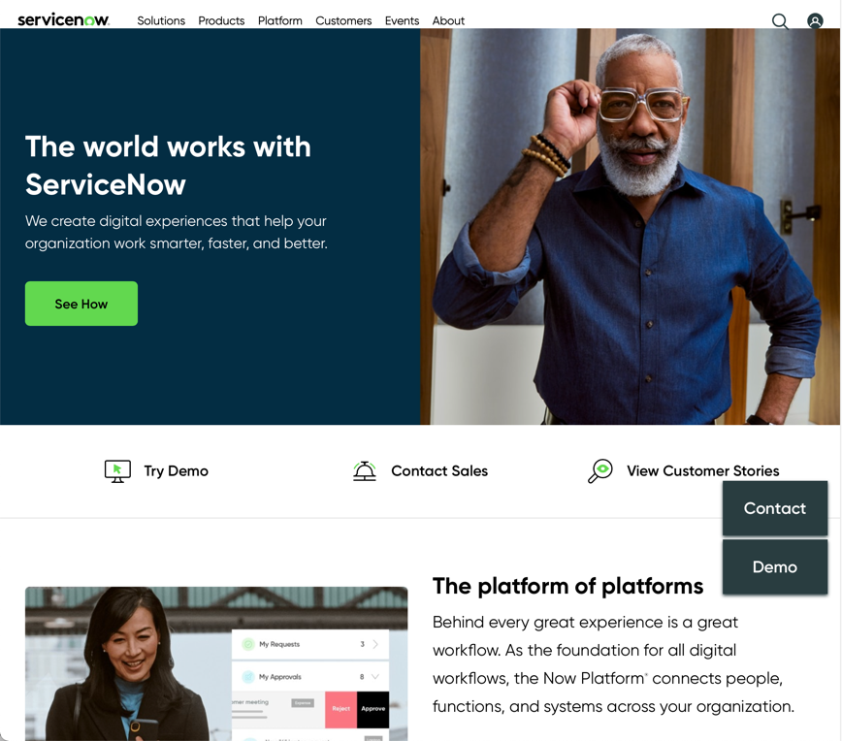
ServiceNow
Corporate website
http://www.servicenow.com/
Demo Site & Support Landing Page
Solutions Overview
Learn More
Professional & Educational Services
Whitepapers, Data Sheets, Video Library
Customer Success Stories
About Us
Partners
News & Events
Sign Up for the ServiceNow Newsletter

Slide 57
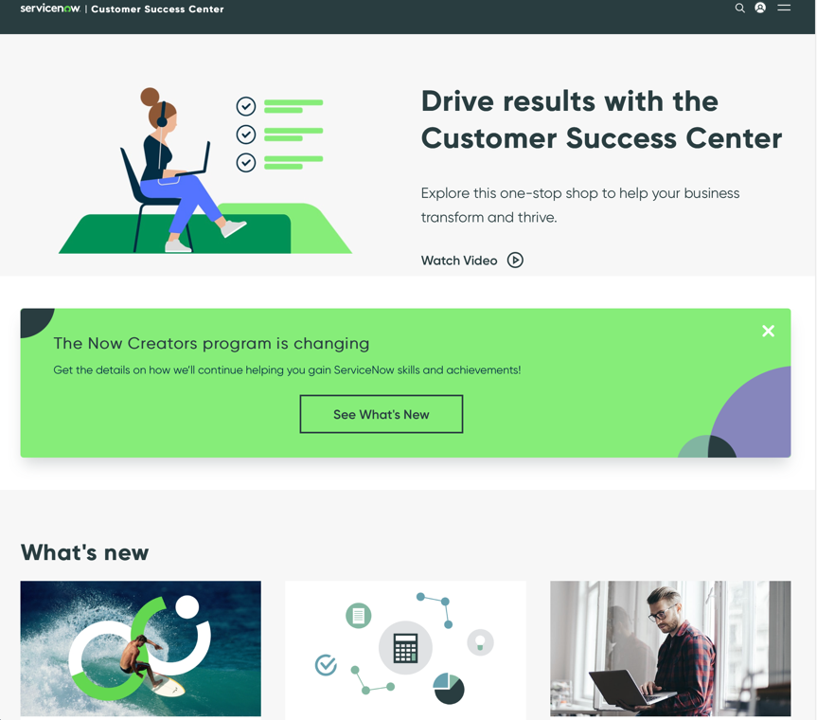
ServiceNow
Customer success center
http://www.servicenow.com/success
Customer’s one-stop hub for fast business outcome achievement.
Valuable Tools to use before, during and after the implementation.
Success Pillars
Success Navigator
Champion Enablement
Instance Upgrades
Business Value Calculators

Slide 58

To-Do List
Remember to complete the following items:
Access Now Create, browse the Success Packs & Assets, and get your Now Create badge
Join the Customer Community
Use Product Documentation
Browse the Corporate Site
Review the Customer Success Center

Slide 59



Sources of information
Update as needed
Platform [name/details]:
Project document location:
MS Team/Slack/Skype:
Notes:
List the various sources of information, as applicable.
Platform Names. Production and Sub-Prod instances
Project documentation location, if using common location
Is the Project using a specific channel to interact?

Slide 60
Product specific kick-off presentation
OPTIONAL
At this stage, there is an opportunity to present a Product Specific Presentation, available for download from servicenow.com/nowcreate
Notes:
At this stage, there is an opportunity to present a Product Specific Presentation, available for download from servicenow.com/nowcreate

Slide 61
Change enablement approach
OPTIONAL
At this stage, there is an opportunity to introduce the approach to Organizational Change Management. You can also consider conducting a specific Kick-Off meeting to cover OCM.

Slide 62

What is change enablement?
Change Enablement is the discipline that guides the way we prepare, equip and support users to successfully adopt change in order to drive business outcomes.

Slide 63
Change enablement approach
The success of our ServiceNow implementation depends on our users’ ability to adopt the new technology and processes in a way that best serves our intended business objectives
The process to prepare our people for this adoption can be broken into the following components:
Planning
The process of conducting extensive stakeholder and business impact and needs analyses to determine readiness, then, to develop plans to drive organizational change
Execution
The process of executing well- laid plans and developing custom, hands-on communications and training for a variety of roles, using a blended learning approach
Adoption
Users can perform their day-to-day operations in the Now Platform® without service interruption. Customers are fully informed and invested in the ServiceNow roll-out
Notes:
Your organization has designed a comprehensive user-readiness strategy to drive user adoption and enable organization-wide change that corresponds with your implementation of ServiceNow applications.
The project team is conducting extensive business impact, stakeholder, and needs analyses to determine readiness and prepare for organizational change.
Subject matters experts (SMEs) develop customized, hands-on training for a variety of roles that are delivered in variety of ways, depending on requirements.
Users can perform their day-to-day operations in the Now Platform without service interruption. Customers are fully informed and invested in the ServiceNow roll-out.
Next Step is to undertake a specific Change Enablement Kick-Off, to start to prepare your organization for the upcoming changes ServiceNow will bring

Slide 64
Next steps
Work with the Portfolio Manager or asset owner to agree the specific product next steps
Workshops:
Objectives
Schedule
Process
What to think about
What is needed from you

Slide 65
Workshop objectives
1
2
3
4
High level discussion on best practices
Review of available features and functions in the platform for implementation consideration
Alignment of the existing [Business] process to best practice recommendations
A team-based process improvement discussion

Slide 66
Workshop schedule
Update as needed
Time | Topic | Additional Information
9am – 5pm, Sept 7, 2020 Location Room | Platform Workshop Details Details | Attendees/Roles: Platform Owner Platform Architect Security Architect System Administrator Developer

Slide 67
What to think about
People
Process
Technology
Information Management
What are the right roles and responsibilities?
Does it deliver the services quality expected?
How to measure success and act on performance?
Where does automation make sense – now and in the future?
What is need to in terms of reports and dashboards, etc.

Slide 68



What we need from you
1
2
3
4
Open, honest dialogue
Collaboration
Willingness to look at things in new ways
Content & context expertise – technical and cultural

Slide 69
Questions?
Contact information goes here

Slide 70
Thank you

